Slide 1
Data 601 @ UMBC
Notes:
See also https://web.stanford.edu/class/stats101/intro/intro-lecture01.pdf for inspiration
Useful: https://arxiv.org/pdf/1503.05570.pdf
A Data Science Course for Undergraduates: Thinking With Data by Ben Baumer, The American Statistician Vol. 69 , Issue. 4
Timing in Fall 2018:
Slide 7 at minute 16
Slide 18 at minute 45
Slide 65 at minute 70
Finished in 2 hours, 20 minutes

Slide 2
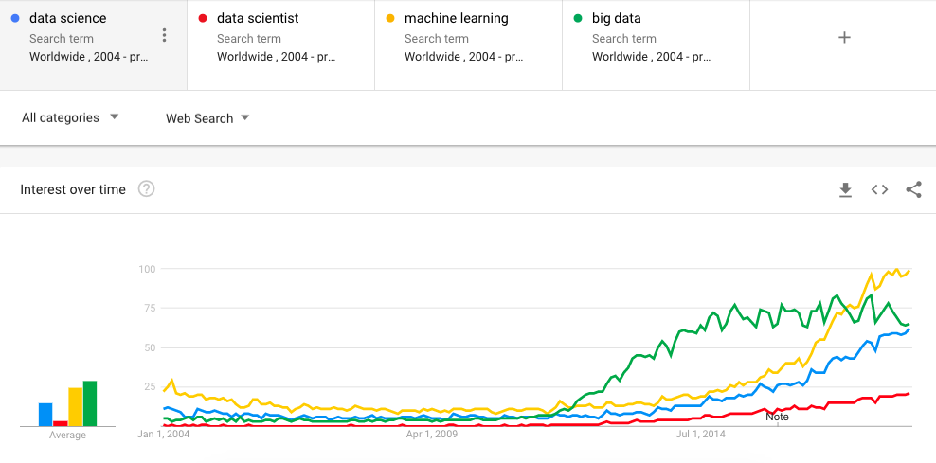
Welcome to Data 601
Notes:
https://trends.google.com/trends/
Blackboard gets used for the voting process in the CSV section of this lecture

Slide 3
Course Logistics
Course Logistics
What is Data Science?
Software tools
What are we not covering?
Data Formats
Soft skills
Homework

Slide 4
Components of a good class
You will need: paper, pen or pencil
How do you promote a safe classroom environment?
How do you address the variety of backgrounds of participants?
How do you encourage participation? Enable rest?
What behavior fosters growth?
Activity: Think, then write

Slide 5
Ground rules
Schedule: 7:10 – 9:40 (we may have breaks)
I value being punctual (start of class, breaks, end of class)
Don't apologize for asking a question or for not knowing something
I find it acceptable for you to occasionally not participate
Tell me if you cannot hear me or if you cannot understand me
Slides/notes will be provided after lecture (Github)
I value your feedback:
Direct: verbal
Indirect: anonymous question/comment sheets on your desk

Slide 6
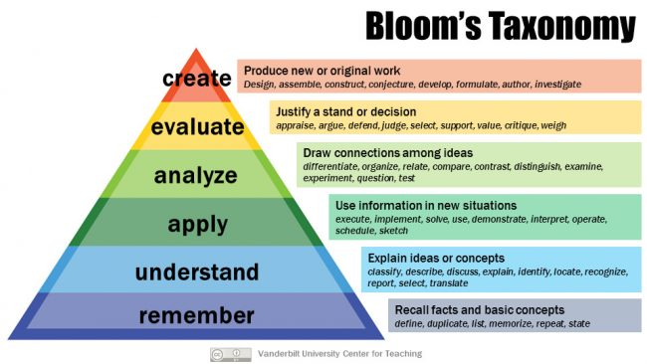
Grading Learning
What you may care about for evaluation
What I care about conveying
Attendance: 10%
Show up for class
Participate in class exercises and surveys
Homework: 30%
When homework is assigned, the due date will be provided
Midterm Project: %30
Final Project: 30%

Slide 7

Log your assumptions and expectations
You will need: paper, pen or pencil
In-class exercise:
Open a notepad(or a word document) on your computer, record the date.
Write down your assumptions about this class
Write down your expectations for this class
Activity: think and write
We will not be sharing the output
Notes:
https://socialnicole.com/how-to-write-wikipedia-article/

Slide 8
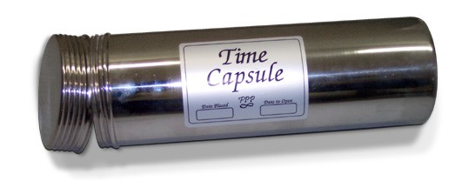
Store assumptions and expectations
We will revisit these notes later in the semester
Store your note where it can be accessed later in the course
Notes:
https://hsefoundation.org/donate/time-capsule/

Slide 9

What do you want to learn in this class?
Activity: verbal popcorn; record answers on board
Notes:
Image source: https://www.compli.com/blog/survey/

Slide 10
What is Data Science?
Course Logistics
What is Data Science?
Software tools
What are we not covering?
Data Formats
Soft skills
Homework

Slide 11
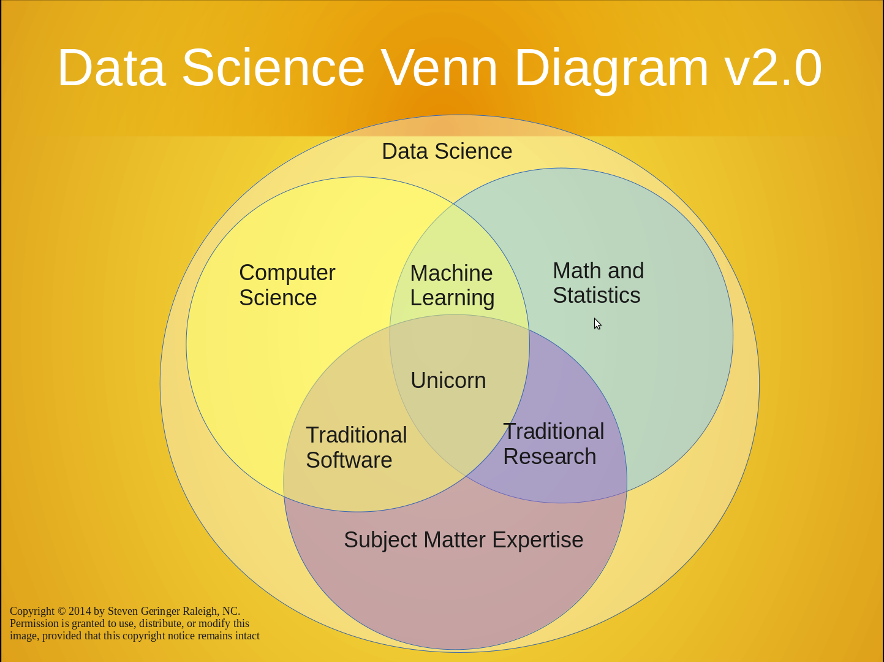
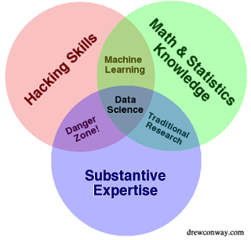
https://www.kdnuggets.com/2016/10/battle-data-science-venn-diagrams.html
There's a lot to cover
Suggested reading:

Slide 12
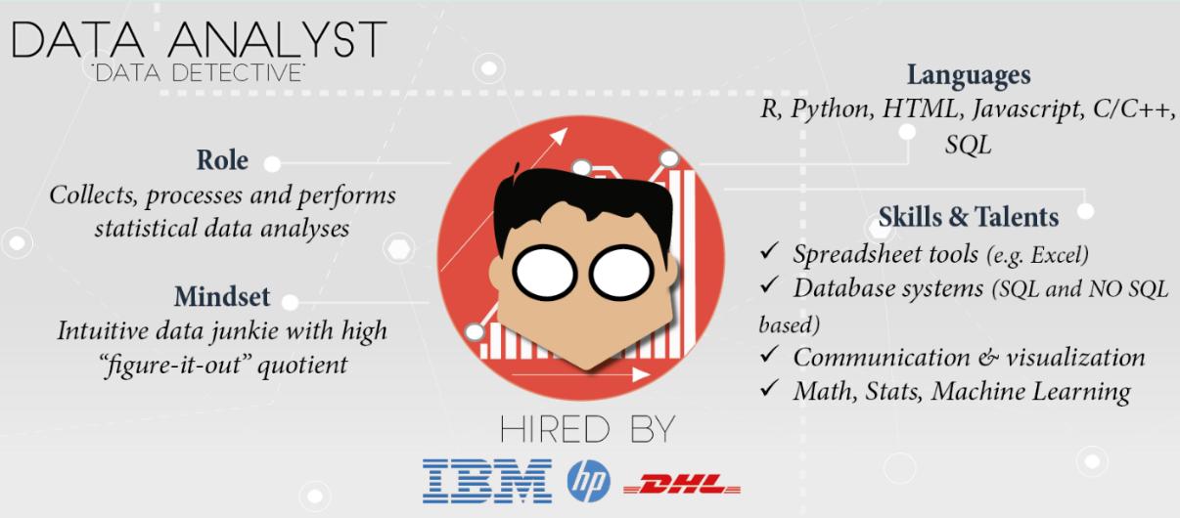
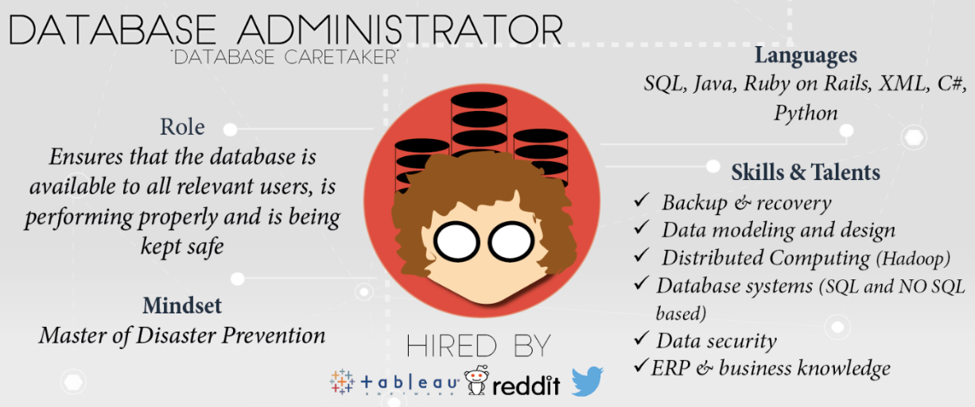
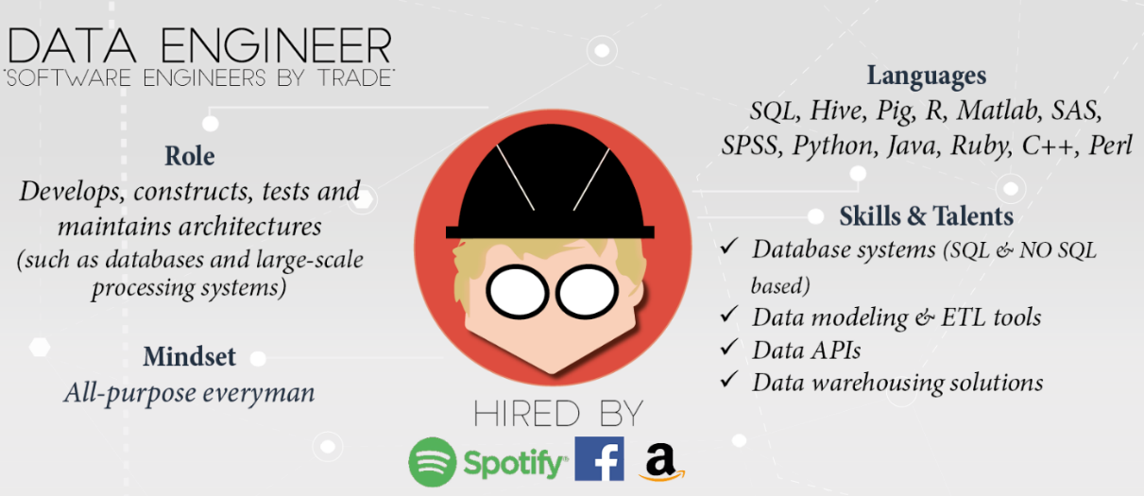
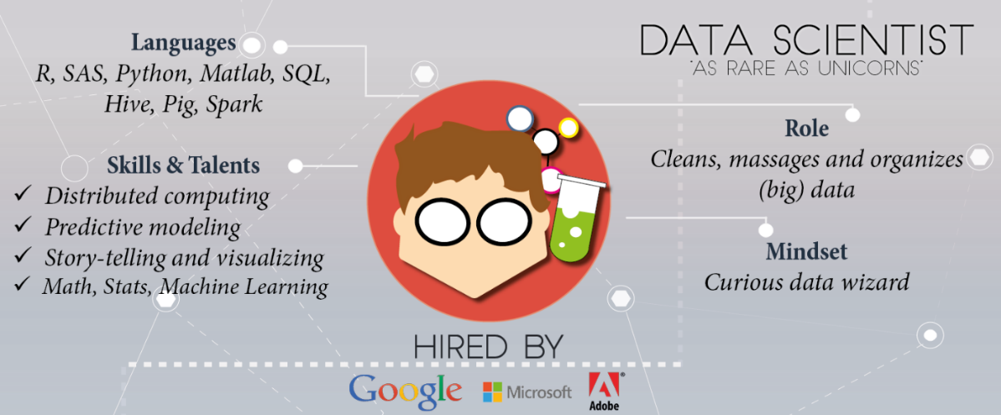
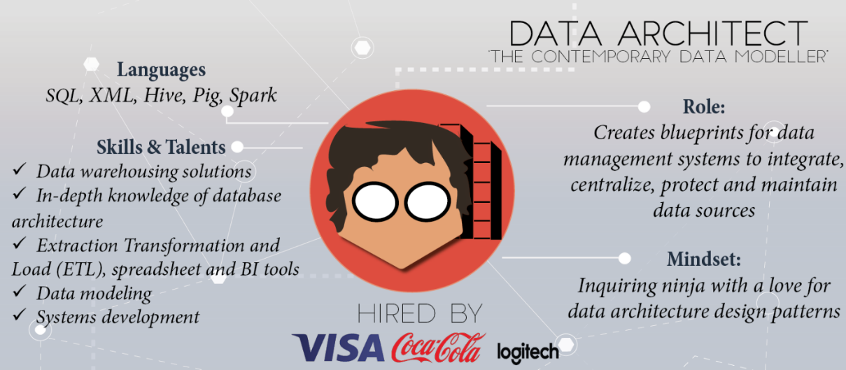
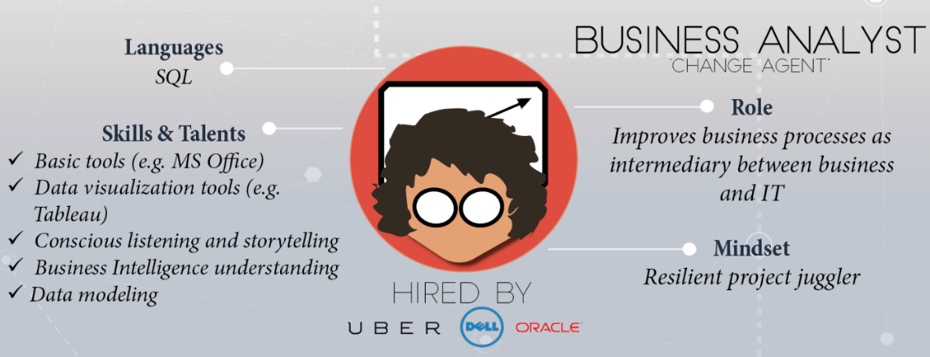
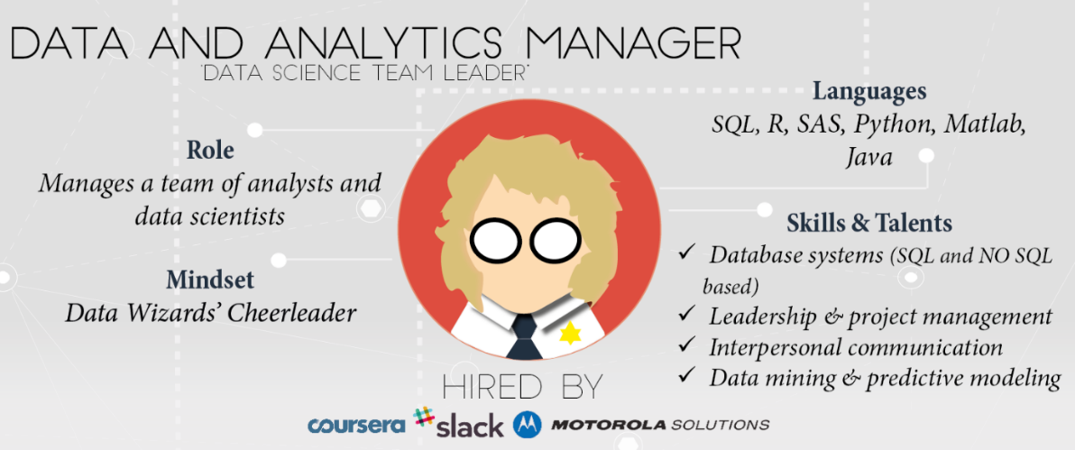
Skills and experience matter more than title and labels
https://www.datacamp.com/community/tutorials/data-science-industry-infographic
Historical progression: data grooming, data mining, data scientist

Slide 13
Data science is an active field with lots of jargon
There will always be something you haven't heard of before.
Know enough to be conversant with peers
Be curious about new topics
Research concepts and labels before using them
Reference: http://www.datascienceglossary.org/

Slide 14
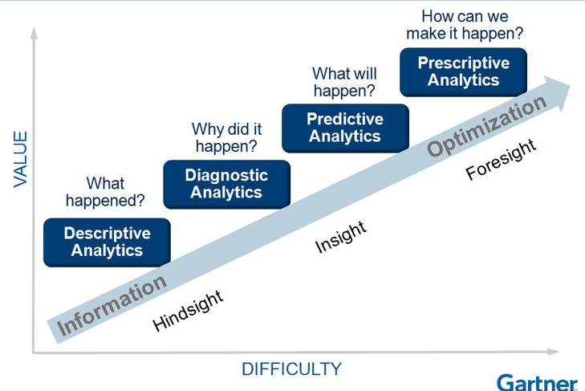
Why learn data science?
Explore: identify patterns​
Predict: make informed guesses​
Infer: quantify what you know
Motives:
Make money
Employment
Promotion
Help people
Gain new knowledge

Slide 15
Large scale use cases with lots of data
Google's search engine
Recommendations from Amazon and Netflix
Bank and Credit Card fraud detection
Logistics (DHL, UPS) of fleet management
Healthcare records from patients
Each depends on availability of compute and data
Notes:
https://www.thrillist.com/entertainment/nation/how-new-netflix-recommendation-algorithm-works#
https://medium.com/netflix-techblog/artwork-personalization-c589f074ad76
https://www.wired.co.uk/article/how-do-netflixs-algorithms-work-machine-learning-helps-to-predict-what-viewers-will-like

Slide 16
Assumption in this class
In class we will assume you are a lone data scientist on an island with an internet connection.
This is not the typical case -- you'll have coworkers, customers, bosses, competitors, collaborators, peers.
Example of how class ≠ real world
This class will not use competitive grading. (Imagine if it were.)
As an employee at a company, you may be competing for a bonus or promotion
--> consequence: personal and organizational politics factor into the work environment

Slide 17
Software Tools
Course Logistics
What is Data Science?
Software tools
What are we not covering?
Data Formats
Soft skills
Homework

Slide 18
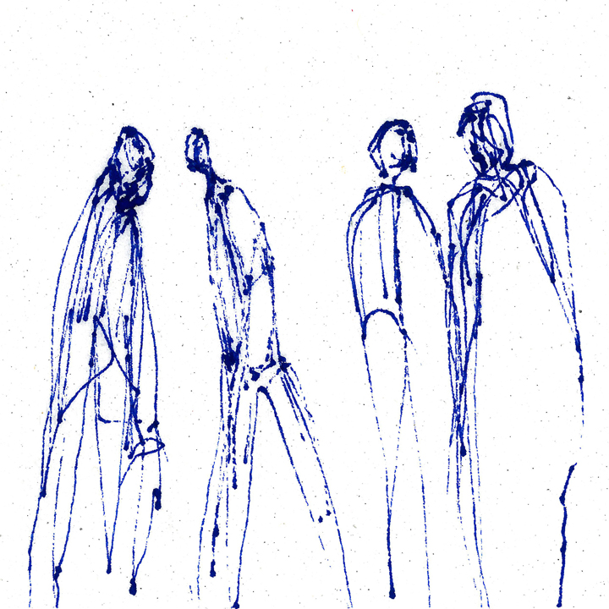
Most popular tool in data science
what do you think the most popular software tool in data science is?
Activity: interactive survey
https://www.trippinsights.com/2018/01/04/milling-about/
Notes:
https://www.trippinsights.com/2018/01/04/milling-about/

Slide 19
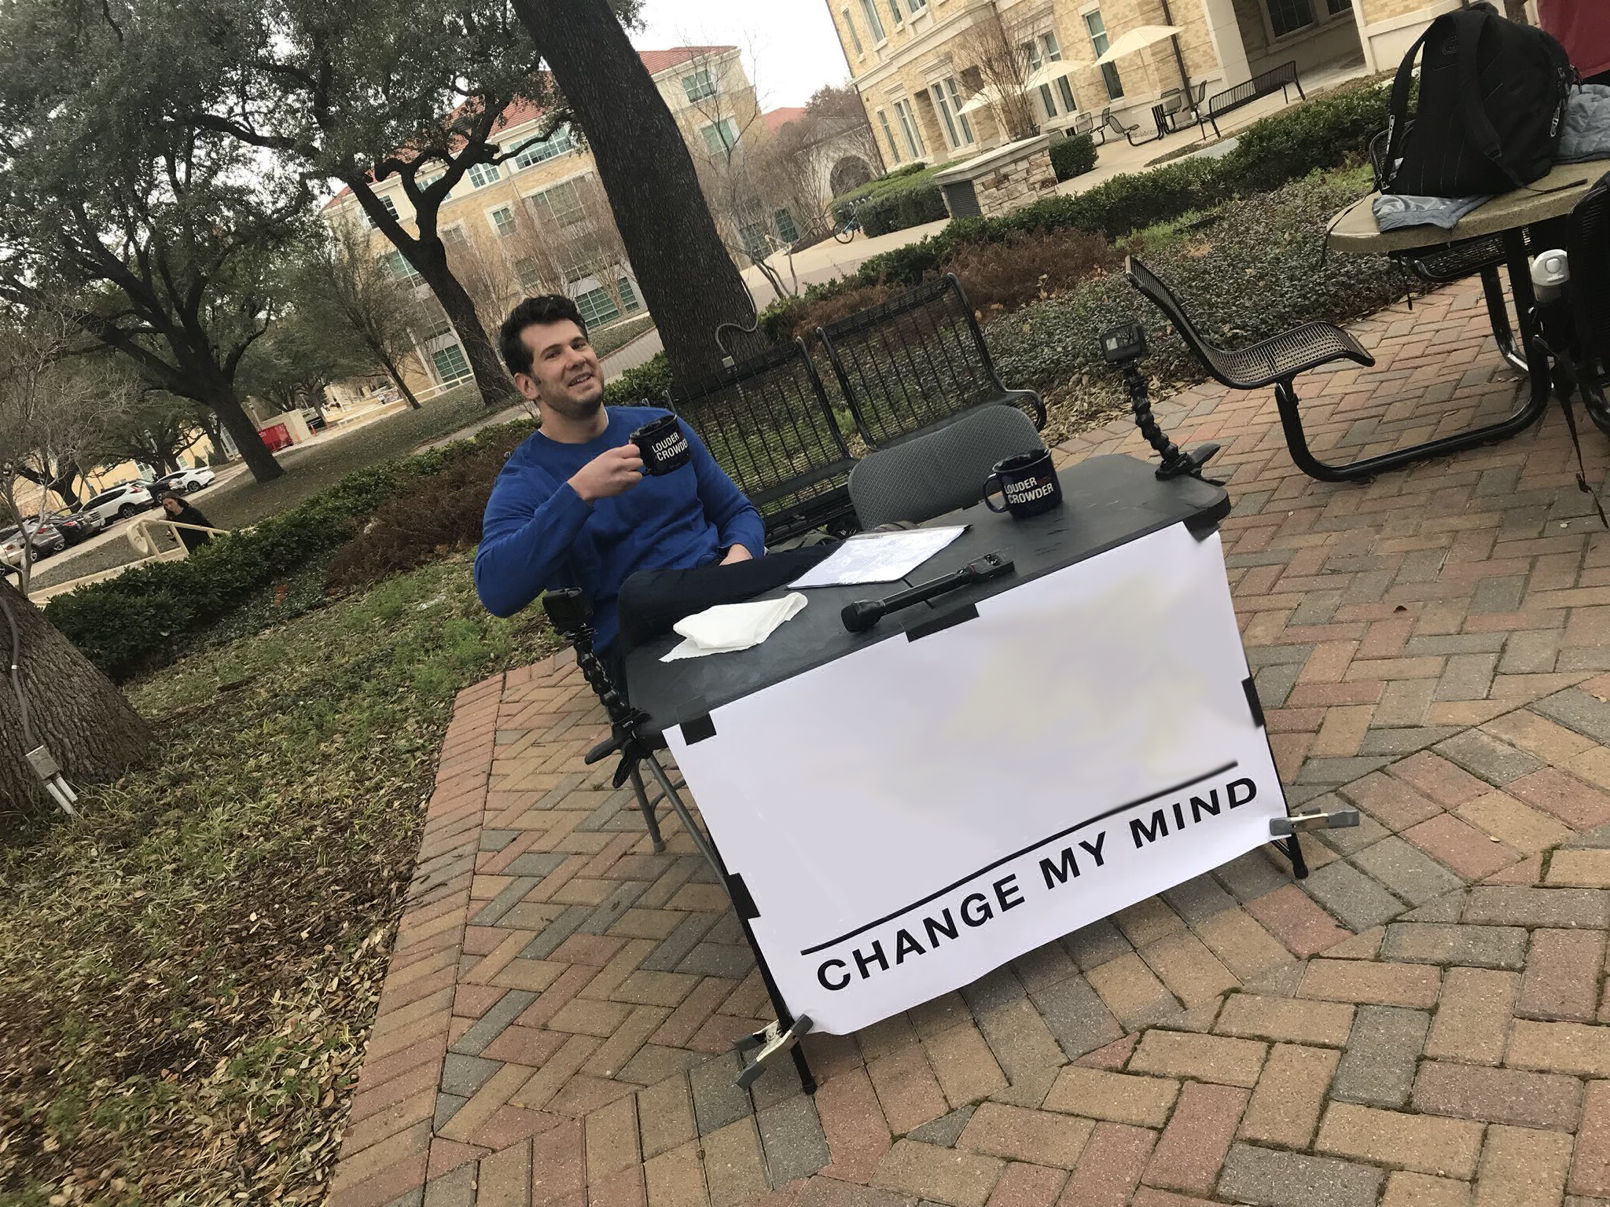
Most popular tool in data science
The most popular tool in data science is Excel.
Excel is attractive because it's flexible and capable -- it can store data, the transform, and the visualization (no context switch).
However, as an analytic ages in Excel and is increasingly tailored, it becomes increasingly brittle.
Also, in the list of capabilities I didn't include documentation.

Slide 20
Most popular tool in Data 601: Python
Notes:
https://me.me/i/mustache-you-a-question-and-please-mullet-over-com-lilahdelilah-4900203

Slide 21


Most popular tool in Data 601: Python
Write in the chat box if you have heard of the programming language called Python

Slide 22
Most popular tool in Data 601: Python
Write in the chat box if you have used the programming language called Python

Slide 23
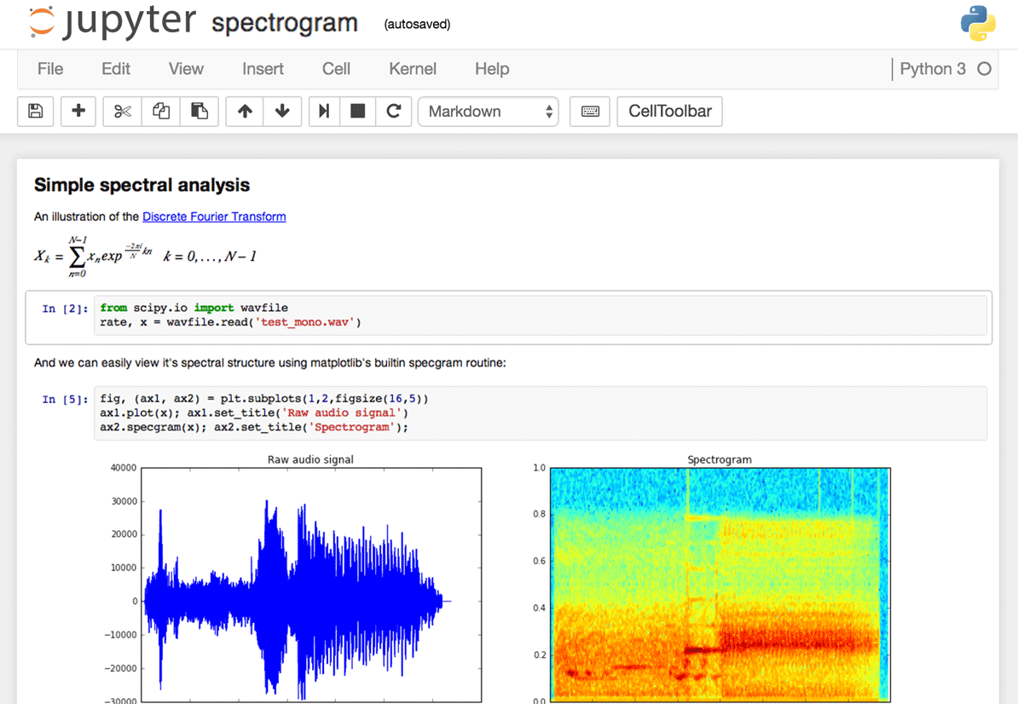
Interface to Python in Data 601: Jupyter
Write in the chat box if you have used a Jupyter notebook
Notes:
Image source: https://www.dataquest.io/blog/jupyter-notebook-tips-tricks-shortcuts/

Slide 24

Why Jupyter + Python for Data 601?
Jupyter is useful for
Exploration of data (jargon: EDA = exploratory data analysis)
Documenting your activities (to enable reproducibility)
Figuring out which software is relevant, which algorithms to use, which software libraries are useful
Visualizing results
And both Jupyter and Python are free!
And both are widely used!
Notes:
Image source: https://imgflip.com/memetemplate/68354308/Do-all-the-things

Slide 25
Python and Jupyter do not cover every use case
For sufficiently large data sets, Jupyter and Python are not the right tool
For sufficiently complex analytics, Jupyter and Python are not the right tool
Speed and security are typically not your priority during exploration
Knowing when to invest in switching tools is a skill
Evaluate trade-offs of flexibility and security and speed for a given scale

Slide 26

Relevance of infrastructure to data science
Usual explanation when replicating analysis:
Get this data
(Documentation) Apply this transformation to get result
No explanation of
software used
software versions
configurations
Implementation details
Digital archeology:
Suppose you are to diagnose why someone else's approach doesn't yield same results
Suppose they did their work 20 years ago

Slide 27
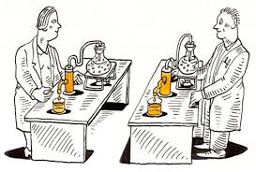
Infrastructure in data science to enable Reproducibility and Portability
In addition to data and analysis, implementation and environment matters
Use this Operating System
Install this software
Configure software this way
Add these packages
Get this data in this format
Run analysis against data
Create plots
Generate report

Slide 28
Best practices: Version control
Reproducibility applies to your own attempts (not just other people)
Regardless of how you develop analytics, you'll be creating or editing software and documents.
[lesson] Regardless of how you implement best practices, avoid inventing solutions for which someone else already provided a path.
Suggested resource: https://try.github.io/

Slide 29

Have you used software for version control?
Activity: Install Anaconda
Examples: git, svn, hg
Activity: Install git
Notes:
https://harveymilk.com/hmcra-family-survey-2/

Slide 30
What are we not covering?
Course Logistics
What is Data Science?
Software tools
What are we not covering?
Data Formats
Soft skills
Homework

Slide 31

Processes external to data science
Exploration may be enough and the effort terminates
Notes:
http://www.wiiplaygameslv.com/catalog/board_games-toyvault/but_wait_theres_more/406443

Slide 32

Processes external to data science
Exploration may be enough and the effort terminates
Additional refinement is often needed; data science is often merely the start of an investment
Notes:
http://www.wiiplaygameslv.com/catalog/board_games-toyvault/but_wait_theres_more/406443

Slide 33
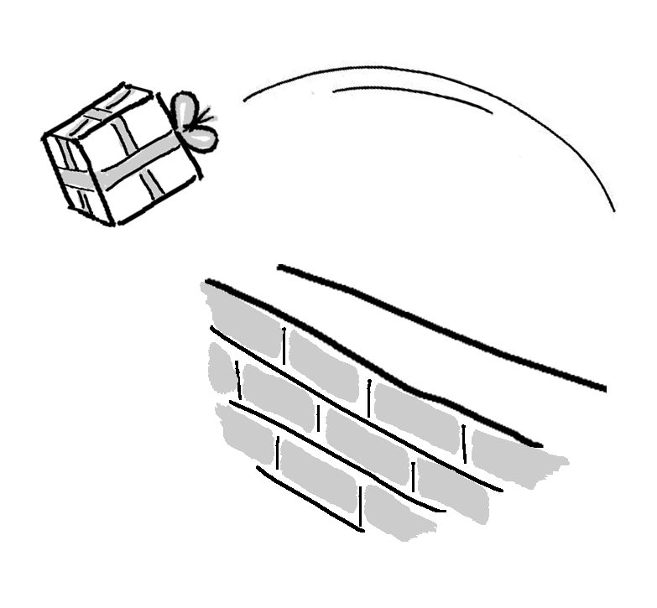
Not covered: machine learning
602 Introduction to Machine Learning covers Machine Learning
If you want to try out, we can do it in one of the last sessions
See http://dev2ops.org/2010/02/what-is-devops/

Slide 34
Not covered: product integration
There's a complex network of dependencies (i.e. software engineers, managers) of which data science is one component.
Downstream consumers of your output are likely to be software developers who use containers and support users.
This class is focused on the data science; not with integration.
See http://dev2ops.org/2010/02/what-is-devops/

Slide 35

Not covered: security
We focus on data science techniques; these do not emphasize secure design of software.
Notes:
https://betanews.com/2014/04/15/windows-8-1-without-update-will-no-longer-receive-security-updates/

Slide 36
Data Formats
Let’s Look at some Python code

Slide 37

Figure 1
Notes:
http://finalfantasy.wikia.com/wiki/Level_grinding
https://en.wikipedia.org/wiki/Grinding_(gaming)
https://www.vectorstock.com/royalty-free-vector/timer-sign-icon-30-minutes-stopwatch-symbol-vector-3756908

Slide 38
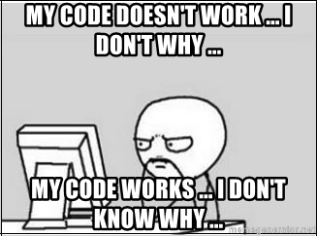
Figure 2
Notes:
http://finalfantasy.wikia.com/wiki/Level_grinding
https://en.wikipedia.org/wiki/Grinding_(gaming)
https://www.vectorstock.com/royalty-free-vector/timer-sign-icon-30-minutes-stopwatch-symbol-vector-3756908

Slide 39
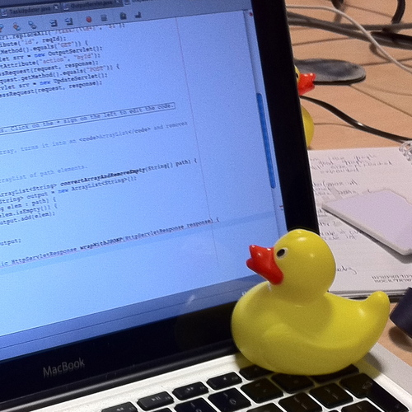
Rubber Duck Debugging
https://en.wikipedia.org/wiki/Rubber_duck_debugging
Notes:
http://finalfantasy.wikia.com/wiki/Level_grinding
https://en.wikipedia.org/wiki/Grinding_(gaming)
https://www.vectorstock.com/royalty-free-vector/timer-sign-icon-30-minutes-stopwatch-symbol-vector-3756908

Slide 40
Data Formats
Course Logistics
What is Data Science?
Software tools
What are we not covering?
Data Formats
Soft skills
Homework

Slide 41
We will discuss: data formats
Examples of data formats
CSV
Excel
JSON
XML
Unstructured text (i.e. txt)
Images (i.e. png, jpg, bmp, svg)
Sound (i.e. mp3, wav)
Images + sound: video
Plain text
Notes:
An outline of what I plan to cover in Data 601
https://www.loc.gov/preservation/resources/rfs/
https://www.loc.gov/preservation/resources/rfs/TOC.html
https://www.loc.gov/preservation/resources/rfs/stillimg.html#photodigital

Slide 42
Data formats
CSV
JSON
XML
Excel
Unstructured text
Images
Sound
Video
Plain text
Platform independent
Not tied to specific software
--> Recommended data formats by the Library of Congress
See http://www.loc.gov/preservation/resources/rfs/data.html
Notes:
An outline of what I plan to cover in Data 601
https://www.loc.gov/preservation/resources/rfs/
https://www.loc.gov/preservation/resources/rfs/TOC.html

Slide 43
unstructured text
image, sound, video
LDA - topic modeling
TF-IDF - document summarization
word2vec - word meaning
OCR - image to text
captioning - text for image
Object detection
Data 601 focus is on numerical data and semi-structured text

Slide 44

Tables: what are they good for?
How would you represent course grades for Data 601 as a table?
(question is intentionally underspecified)
Activity: Raise your hand/Write in chatbox if you have a suggestion

Slide 45
Example of a table for course grades
Last Name | First Name | Homework 1 grade | Homework 2 grade | Exam grade
rgiasg | igmign | 79 | 84 | 92
qgimzf | gvdvig | 73 | 86 | 96
asgmi | ybgngfj | 58 | 42 | 71

Slide 46
Tables: what are they good for?
How would you represent a corpus of emails?
(question is intentionally underspecified)
Activity: Raise your hand/Write in chatbox if you have a suggestion

Slide 47
Example of a table for emails
Subject | From | To | Date | Has Attachment?
Doggy | Bob@gmail.com | Sam@yahoo.com | 2018-08-30 | N
Meeting time | Sam@yahoo.com | Alice@hotmail.com | 2018-09-01 | N
syllabus | Alex@gmail.com | Ari@gmail.com | 2018-09-06 | Y

Slide 48
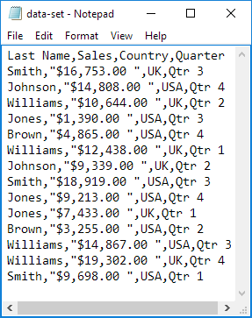
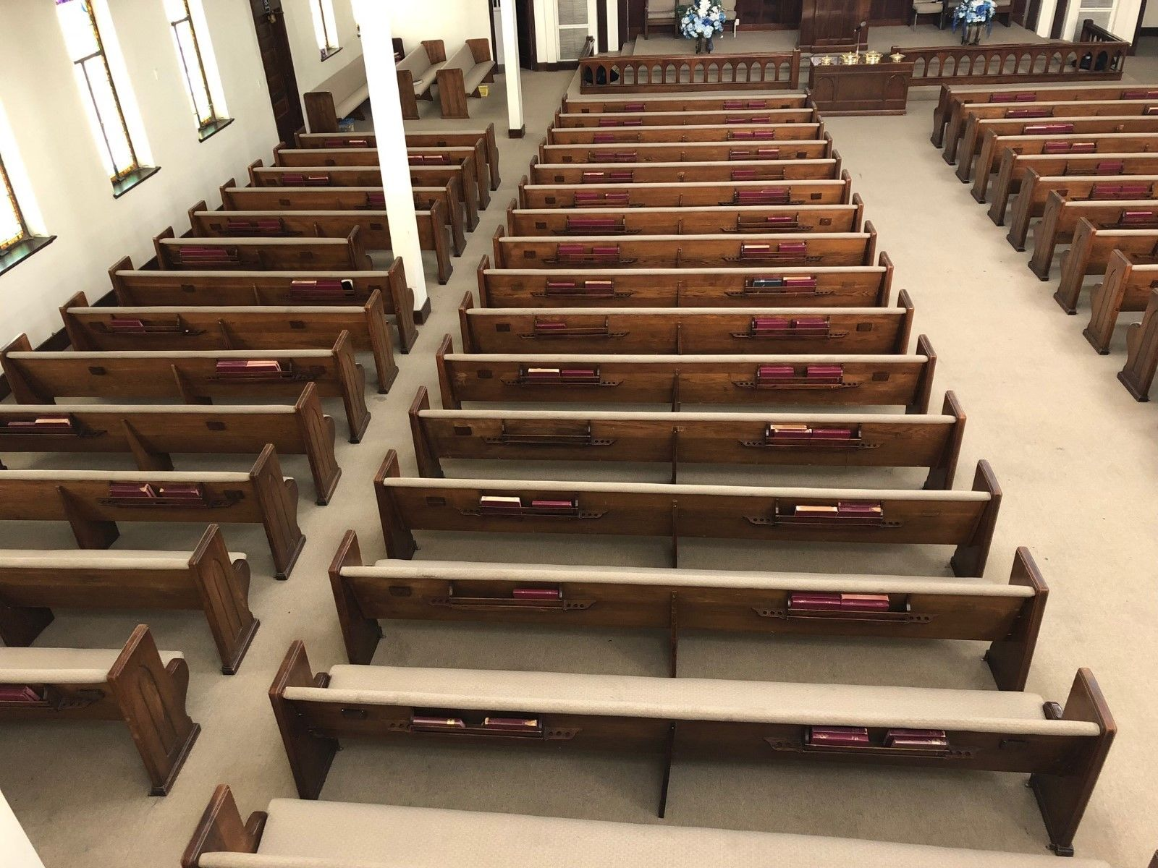

CSV
No set standard; see https://tools.ietf.org/html/rfc4180
https://en.wikipedia.org/wiki/Comma-separated_values
A table with rows and columns composed of text
Notes:
https://www.excel-easy.com/examples/import-export-text-files.html

Slide 49
CSV
No set standard; see https://tools.ietf.org/html/rfc4180
https://en.wikipedia.org/wiki/Comma-separated_values
A table with rows and columns composed of text
delimiters:
Line break (separates rows)
Comma (separates columns)
May or may not have a header:
First row is descriptions of columns
Notes:
https://www.excel-easy.com/examples/import-export-text-files.html

Slide 50
CSV caveats
Text (not images, audio, video)
Each column of same type
Name or word or description (text)
Number
Category label (text)
Delimiters within a value
Enclosed within a pair of double quotes: " "
Quotes for quotes, ie 24"
Notes:
Image: https://www.excel-easy.com/examples/import-export-text-files.html
https://tools.ietf.org/html/rfc4180
https://stackoverflow.com/questions/17808511/properly-escape-a-double-quote-in-csv

Slide 51
CSV variations
Delimiters vary:
Tab – see https://en.wikipedia.org/wiki/Tab-separated_values
| (pipe)
Month|count|location
Jan|1332|here
June|5,593|there
Feb|953,24|everywhere, CA
Oct|592|my home town, MD
Can you see why using pipes would be desirable?
Notes:
https://en.wikipedia.org/wiki/Delimiter-separated_values

Slide 52
CSV alternative: fixed width
Consistent number of characters per column
ID l_name f_nametuition
0585822Potter, JrHarry 204
0485572Weasley Ron 958
5924245Granger Hermio422
4724926Diggory Cedric1042
4938243Weasley Fred 394
Can you see why fixed width would be desirable?
Notes:
https://www.excel-easy.com/examples/import-export-text-files.html

Slide 53
CSV alternative: fixed width
Consistent number of characters per column
ID l_name f_nametuition
0585822Potter, JrHarry 204
0485572Weasley Ron 958
5924245Granger Hermio422
4724926Diggory Cedric1042
4938243Weasley Fred 394
Caveat: each column needs to be at least as long as the longest entry
Notes:
https://www.excel-easy.com/examples/import-export-text-files.html

Slide 54

CSV quiz
When you see the question, don't shout out the answer.
Use Blackboard for voting on answers;
the colored cards are a backup.

Slide 55
Name, year, class, grade
Ming, 2013, Data 601, B
Imgb, 2015, Data 601, B
Rimgw, 2012, Data 601, A
Wemf, 2014, Data 602, C

Slide 56
Name, year, class, grade
Ming, 2013, Data 601, B
Imgb, 2015, Data 601, B
Rimgw, 2012, Data 601, A
Wemf, 2014, Data 602, C
Q: Does this CSV have a header?
(Don't shout out the answer)

Slide 57
Name, year, class, grade
Ming, 2013, Data 601, B
Imgb, 2015, Data 601, B
Rimgw, 2012, Data 601, A
Wemf, 2014, Data 602, C
Q: Does this CSV have a header?
Backup voting:
YES
NO
NOT SURE

Slide 58
Name, year, class, grade
Ming, 2013, Data 601, B
Imgb, 2015, Data 601, B
Rimgw, 2012, Data 601, A
Wemf, 2014, Data 602, C
Q: Does this CSV have a header?
Answer -- YES
NO
NOT SURE

Slide 59
Name, year, class, grade
Ming, 2013, Data 601, B
Imgb, 2015, Data 601, B
Rimgw, 2012, Data 601, A
Wemf, 2014, Data 602, C
Q: How many rows does this CSV have?
(Don't shout out the answer)

Slide 60
Name, year, class, grade
Ming, 2013, Data 601, B
Imgb, 2015, Data 601, B
Rimgw, 2012, Data 601, A
Wemf, 2014, Data 602, C
Q: How many rows does this CSV have?
5 rows
4 rows
NOT SURE

Slide 61
Row 1:
Row 2:
Row 3:
Row 4:
Row 5:
Name, year, class, grade
Ming, 2013, Data 601, B
Imgb, 2015, Data 601, B
Rimgw, 2012, Data 601, A
Wemf, 2014, Data 602, C
Col 1, Col 2, Col 3, Col 4
Q: How many rows does this CSV have?
Answer -- 5 rows
4 rows
NOT SURE
Why not 4?
Header is a row
Rows (5) versus columns (4)

Slide 62

ID, last name, first name, tuition
058582, Potter, Jr, Harry, $204
0485572, Weasley, Ron, $958
592424, Granger, Hermione, $422
472492, Diggory, Cedric, $1,042
493824, Weasley, Fred, $394
Q: What is wrong with this CSV?
Activity: Raise your hand/Write in chatbox if you have an answer
Notes:
https://support.clever.com/hc/en-us/articles/218518698-How-do-I-troubleshoot-CSV-formatting-errors-
image
https://bensbargains.com/thecheckout/awesomeness/25-hilarious-images-will-definitely-trigger-nerd-rage/

Slide 63

ID, last name, first name, tuition
058582, "Potter, Jr", Harry, $204
0485572, Weasley, Ron, $958
592424, Granger, Hermione, $422
472492, Diggory, Cedric, "$1,042"
493824, Weasley, Fred, $394
Q: What is wrong with this CSV?
A: Two mistakes with unquoted commas
Notes:
https://support.clever.com/hc/en-us/articles/218518698-How-do-I-troubleshoot-CSV-formatting-errors-
image
https://bensbargains.com/thecheckout/awesomeness/25-hilarious-images-will-definitely-trigger-nerd-rage/

Slide 64
Jupyter and CSV
load_csv.ipynb

Slide 65
reasons not to use CSV data format
data type of columns undefined
--> string versus float versus integer
This makes loading data from file to memory expensive
consistency of data types per row is not guaranteed
Row 1 could be "Bob, 52, 485-2949" while
Row 2 could be "859492, mark@yahoo.com, $95"
Format consistency is not enforced
Header could be comma separated, data is pipe separated, except fourth and fifth column are separated by semicolon
See Falsehoods Programmers Believe About CSVs

Slide 66
Additional common data formats: JSON and XML
Semi-structured_data for flexibility
JSON jargon: Key-value pairs
XML jargon: Tags, Elements, Attributes
Attributes contain data related to a specific element

Slide 67
Data format: JavaScript Object Notation (JSON)
{"menu": { "id": "file", "value": "File", "popup": { "menuitem": [ {"value": "New", "onclick": "CreateNewDoc()"}, {"value": "Open", "onclick": "OpenDoc()"}, {"value": "Close", "onclick": "CloseDoc()"} ] } }}
source: https://json.org/example.html
https://tools.ietf.org/html/rfc4627
Notes:
https://www.w3schools.com/js/js_json_intro.asp
https://beginnersbook.com/2015/04/json-tutorial/
https://www.tutorialspoint.com/json/

Slide 68
Data format: JavaScript Object Notation (JSON)
{"menu": { "id": "file", "value": "File", "popup": { "menuitem": [ {"value": "New", "onclick": "CreateNewDoc()"}, {"value": "Open", "onclick": "OpenDoc()"}, {"value": "Close", "onclick": "CloseDoc()"} ] } }}
source: https://json.org/example.html
https://tools.ietf.org/html/rfc4627
Notes:
https://www.w3schools.com/js/js_json_intro.asp
https://beginnersbook.com/2015/04/json-tutorial/
https://www.tutorialspoint.com/json/

Slide 69
Data format: JavaScript Object Notation (JSON)
{"menu": { "id": "file", "value": "File", "popup": { "menuitem": [ {"value": "New", "onclick": "CreateNewDoc()"}, {"value": "Open", "onclick": "OpenDoc()"}, {"value": "Close", "onclick": "CloseDoc()"} ] } }}
source: https://json.org/example.html
https://tools.ietf.org/html/rfc4627
Notes:
https://www.w3schools.com/js/js_json_intro.asp
https://beginnersbook.com/2015/04/json-tutorial/
https://www.tutorialspoint.com/json/

Slide 70
How many key-value pairs does this JSON feature?
{"menu": { "id": "file", "value": "File", "popup": { "menuitem": [ {"value": "New", "onclick": "CreateNewDoc()"}, {"value": "Open", "onclick": "OpenDoc()"}, {"value": "Close", "onclick": "CloseDoc()"} ] } }}
source: https://json.org/example.html
https://tools.ietf.org/html/rfc4627
Notes:
https://www.w3schools.com/js/js_json_intro.asp
https://beginnersbook.com/2015/04/json-tutorial/
https://www.tutorialspoint.com/json/

Slide 71
How many key value pairs does this JSON feature?
{"menu": { "id": "file", "value": "File", "popup": { "menuitem": [ {"value": "New", "onclick": "CreateNewDoc()"}, {"value": "Open", "onclick": "OpenDoc()"}, {"value": "Close", "onclick": "CloseDoc()"} ] } }}
source: https://json.org/example.html
https://tools.ietf.org/html/rfc4627
There are 11 key value pairs
Notes:
https://www.w3schools.com/js/js_json_intro.asp
https://beginnersbook.com/2015/04/json-tutorial/
https://www.tutorialspoint.com/json/

Slide 72
Reading JSON in Jupyter
load_json.ipynb

Slide 73
Data format: Extensible Markup Language (XML)
<menu id="file" value="File"> <popup> <menuitem value="New" onclick="CreateNewDoc()" /> <menuitem value="Open" onclick="OpenDoc()" /> <menuitem value="Close" onclick="CloseDoc()" /> </popup> </menu>
Element
Attribute
source: https://json.org/example.html
https://tools.ietf.org/html/rfc2376
attributes cannot contain multiple values (elements can)
attributes cannot contain tree structures (elements can)
Source: https://www.w3schools.com/xml/xml_attributes.asp
Notes:
https://www.w3schools.com/xml/
https://www.w3schools.com/xml/xml_whatis.asp
https://www.tutorialspoint.com/xml/

Slide 74
Multiple representations in XML
<person>
<firstName>John</firstName>
<lastName>Smith</lastName>
<age>25</age>
<address>
<street>21 2nd Street</street>
<city>New York</city>
<state>NY</state>
<zip>10021</zip>
</address>
</person>
There are no rules about when to use attributes or when to use elements in XML.
Source: https://en.wikipedia.org/wiki/JSON#XML_samples
<person firstName="John" lastName="Smith" age="25">
<address street="21 2nd Street" city="New York" state="NY" zip="10021" />
</person>

Slide 75
Reading XML in Jupyter
load_xml.ipynb

Slide 76
There are more data formats used in different situations
HDF5 – for extremely large and complex data collections.
pickle - data serialization for Python
See https://www.benfrederickson.com/dont-pickle-your-data/

Slide 77
Soft skills
Course Logistics
What is Data Science?
Software tools
What are we not covering?
Data Formats
Soft skills
Homework

Slide 78
Data Science is more than Math and Software
Human interaction in data science
Discovering stakeholders
Negotiating with data owners
Customer engagement
https://hbr.org/2017/01/the-best-data-scientists-get-out-and-talk-to-people

Slide 79
Iterating with customers
As a data scientist, you'll often be working for someone other than yourself.
Expect under-specified requirements from customers. Iterate.
Provide incomplete solutions rather than waiting until the product is perfect.
https://en.wikipedia.org/wiki/Minimum_viable_product

Slide 80

When to persist, When to change course, When to seek help
Try attacking the challenge for 30 minutes
Then seek help or do something else for a while
https://en.wikipedia.org/wiki/Pomodoro_Technique
Notes:
http://finalfantasy.wikia.com/wiki/Level_grinding
https://en.wikipedia.org/wiki/Grinding_(gaming)
https://www.vectorstock.com/royalty-free-vector/timer-sign-icon-30-minutes-stopwatch-symbol-vector-3756908

Slide 81
Pro-tip when seeking help
How to ask well-formed questions:
https://stackoverflow.com/help/how-to-ask
[Intentional sidetrack to StackOverflow.]
Ask technical questions:
Poor: "I don't understand Python dictionaries" (--> online tutorials)
Better: "When is it appropriate to use a key-value pair?"
Poor: If I submitted this assignment as is, what score would I get?
Better: I am planning to submit the attached assignment, but currently there's an error in the third cell. I've searched online but don't find any references to the error message. Can you provide guidance?

Slide 82

Emotions in Data Science
As a data scientist, most of your time will be spent in a desert of uncertainty, frustration, and doubt.
There will be rare short-lived interspersed spikes of excitement and happiness due to events like getting a new dataset, creating a new analytic, getting a new result, or being thanked by a stakeholder.
This experience is normal and does not go away.
See also the psychology of slot machines
Notes:
https://www.vhtcx.com/wp-content/uploads/2015/02/canstockphoto3986275.jpg
https://www.vhtcx.com/blog/5-causes-customer-frustration-fix/

Slide 83
Homework
Course Logistics
What is Data Science?
Software tools
What are we not covering?
Data Formats
Soft skills
Homework

Slide 84
Task: Jupyter with Python 3 kernel
Recommended: Local installation on your computer
https://www.anaconda.com/
Backup: Web-based (free, no guarantee of availability, features vary)
https://colab.research.google.com/
https://mybinder.org/
Depends on reference to github repository

Slide 85
Homework
Read: First 10 pages of "50 years of data science"
Write a half page summary of the text
Submit essay via Blackboard
2. Complete Homework-week1.ipynb
Submit it as ipython notebook to Blackboard
Action: Read, write, tell
Notes:
Timeline: http://www.dataversity.net/brief-history-data-science/

Slide 86
Online resources (in addition to books)
Meetups
https://www.meetup.com/topics/data-science/
https://www.meetup.com/BigDataBaltimore/
https://www.meetup.com/Statistical-Seminars-DC/events/254200651/
News and blogs
https://www.kdnuggets.com/
https://news.ycombinator.com/
https://hackernoon.com/
https://www.reddit.com/r/datascience/
https://dataelixir.com/newsletters/
Online courses
Coursera
https://www.coursera.org/learn/machine-learning/home/welcome

